Slide 1
Loan Analysis Report
HSBC UK

Slide 2
2
Introduction
This report presents a detailed analysis of HSBC UK's loan data, focusing on applicant profiles, loan characteristics, and credit history to identify trends and enhance strategic decision-making.

Slide 3
3
Table of contents
Understand the Problem
Exploratory Data Analysis
Advanced Analytics
Strategic Recommendations
Power BI Dashboard

Slide 4
4
Understand the Problem

Slide 5
5
Understand the Problem
Objectives of the Analysis
Evaluate the risk associated with the loan portfolio
Optimize lending strategies by identifying profitable customer segments
Develop data-driven insights to improve credit risk management
Visualize key trends and KPIs using Power BI for strategic decision-making
Understand borrower characteristics and their impact on loan performance

Slide 6
6
Understand the Problem
Analysis Tools
Python
For initial exploration and data quality validation
SQL Server
For preparing and analyzing data using SQL scripts
For creating interactive dashboards and visualizing key metrics
Power BI

Slide 7
7
Understand the Problem
Methodology
Data Extraction & Cleaning
Query the loan dataset from HSBC
Perform data cleaning
Exploratory Data Analysis (EDA)
Analyse loan distribution, borrower profile
Advanced Analytics
Analyse borrower solvency
Dashboarding
Develop visual reports highlighting key insights
Identify high-risk segments
Identify correlations between key variables

Slide 8
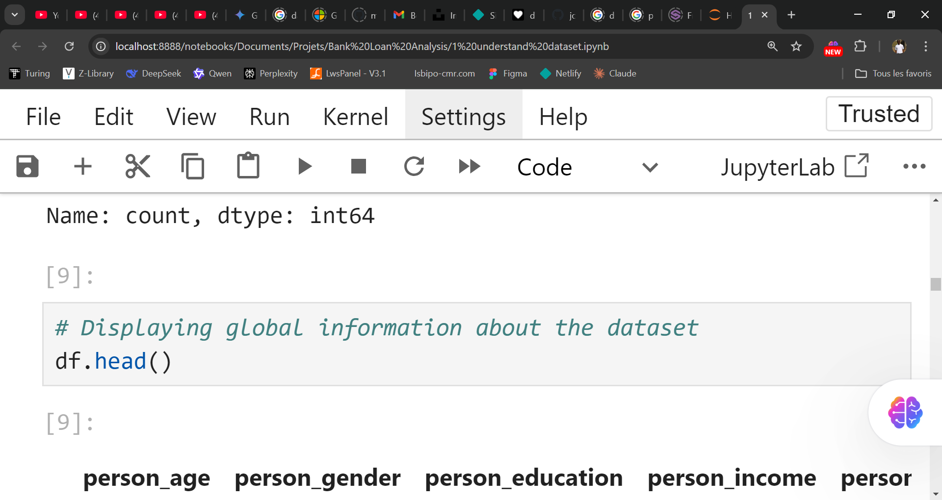
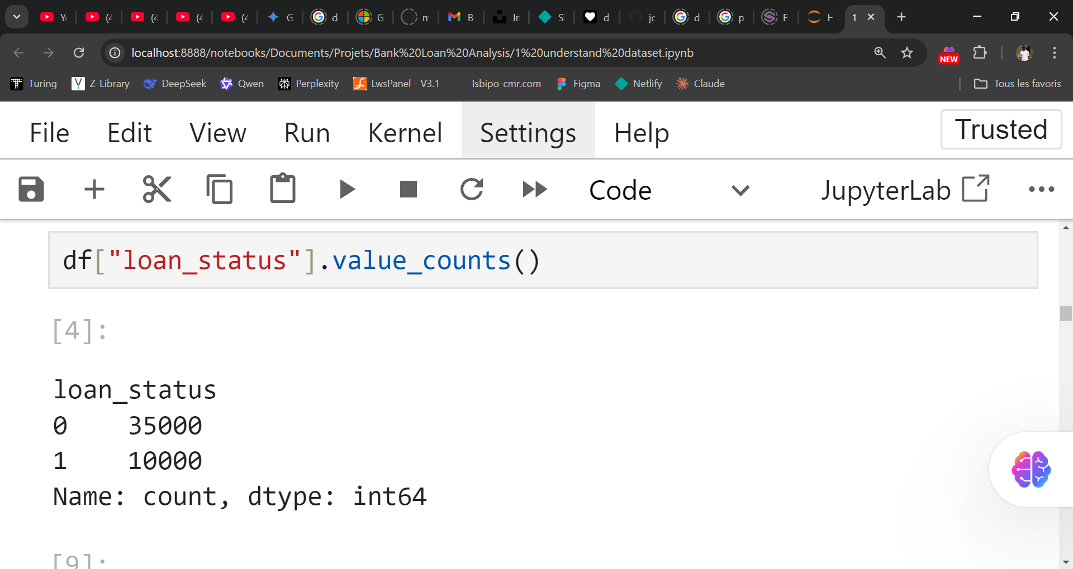
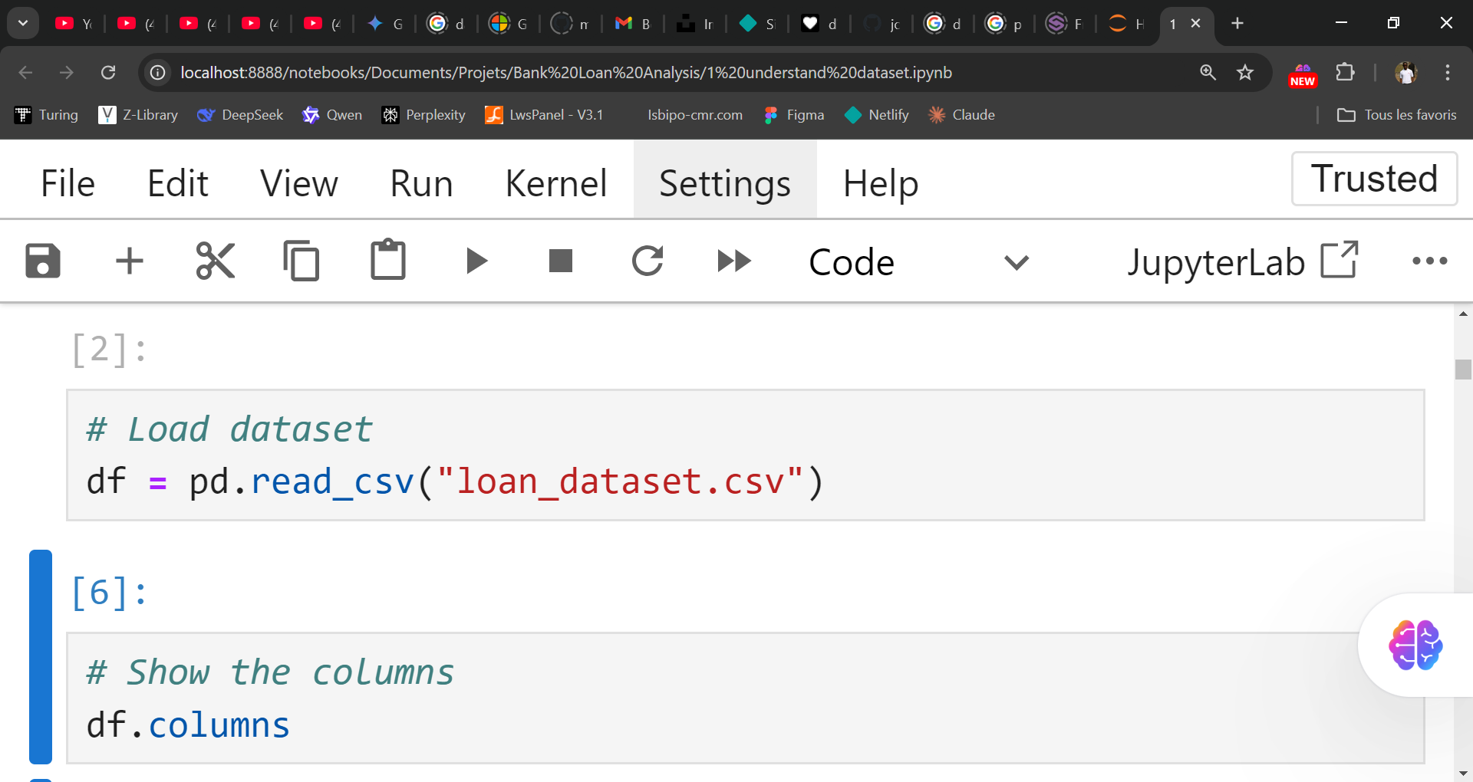
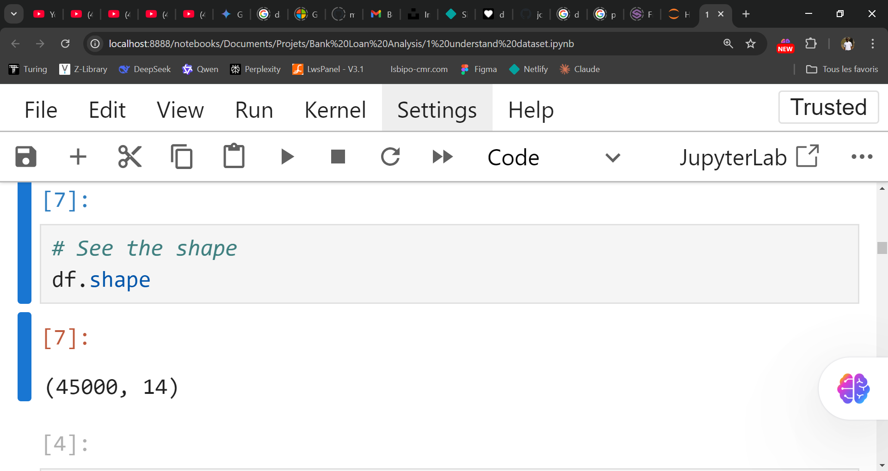
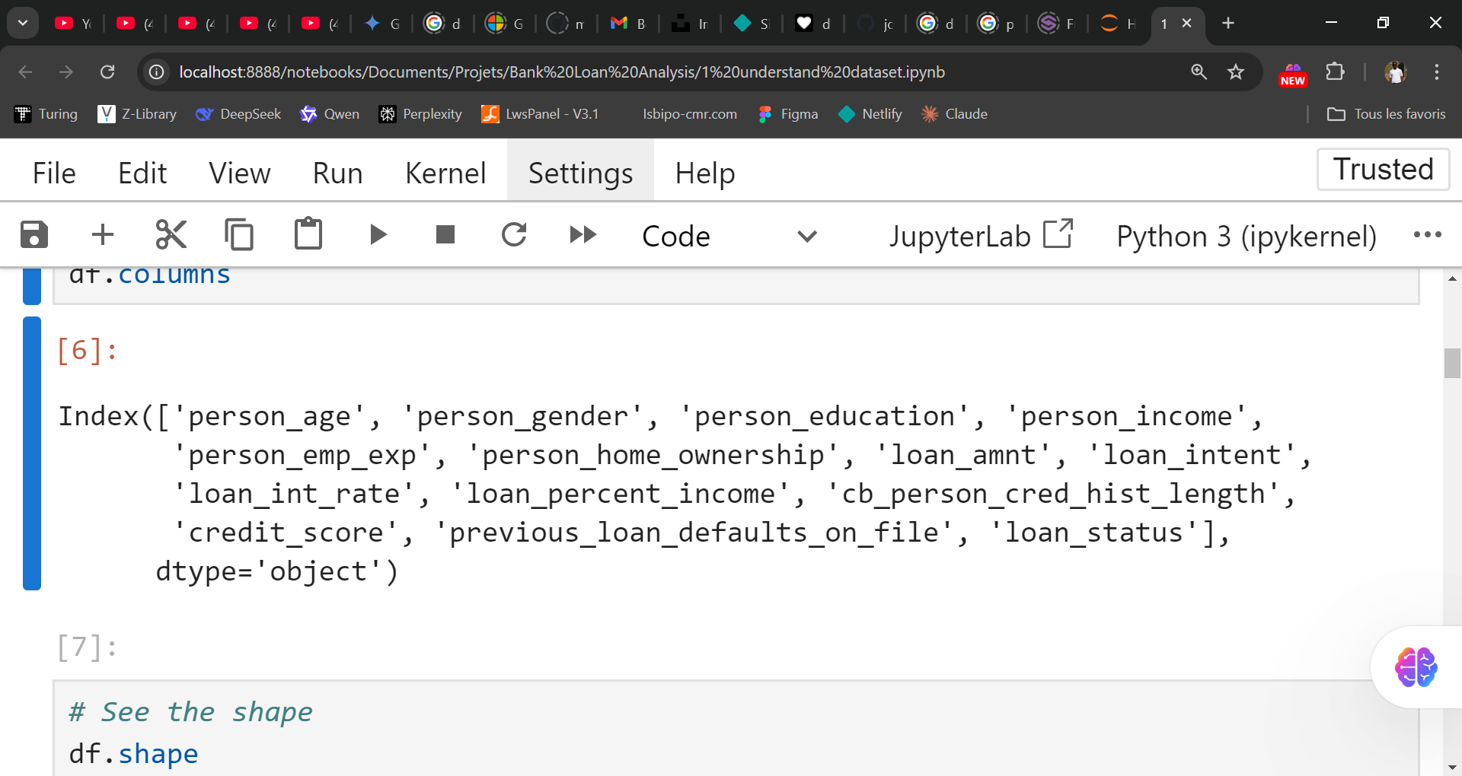
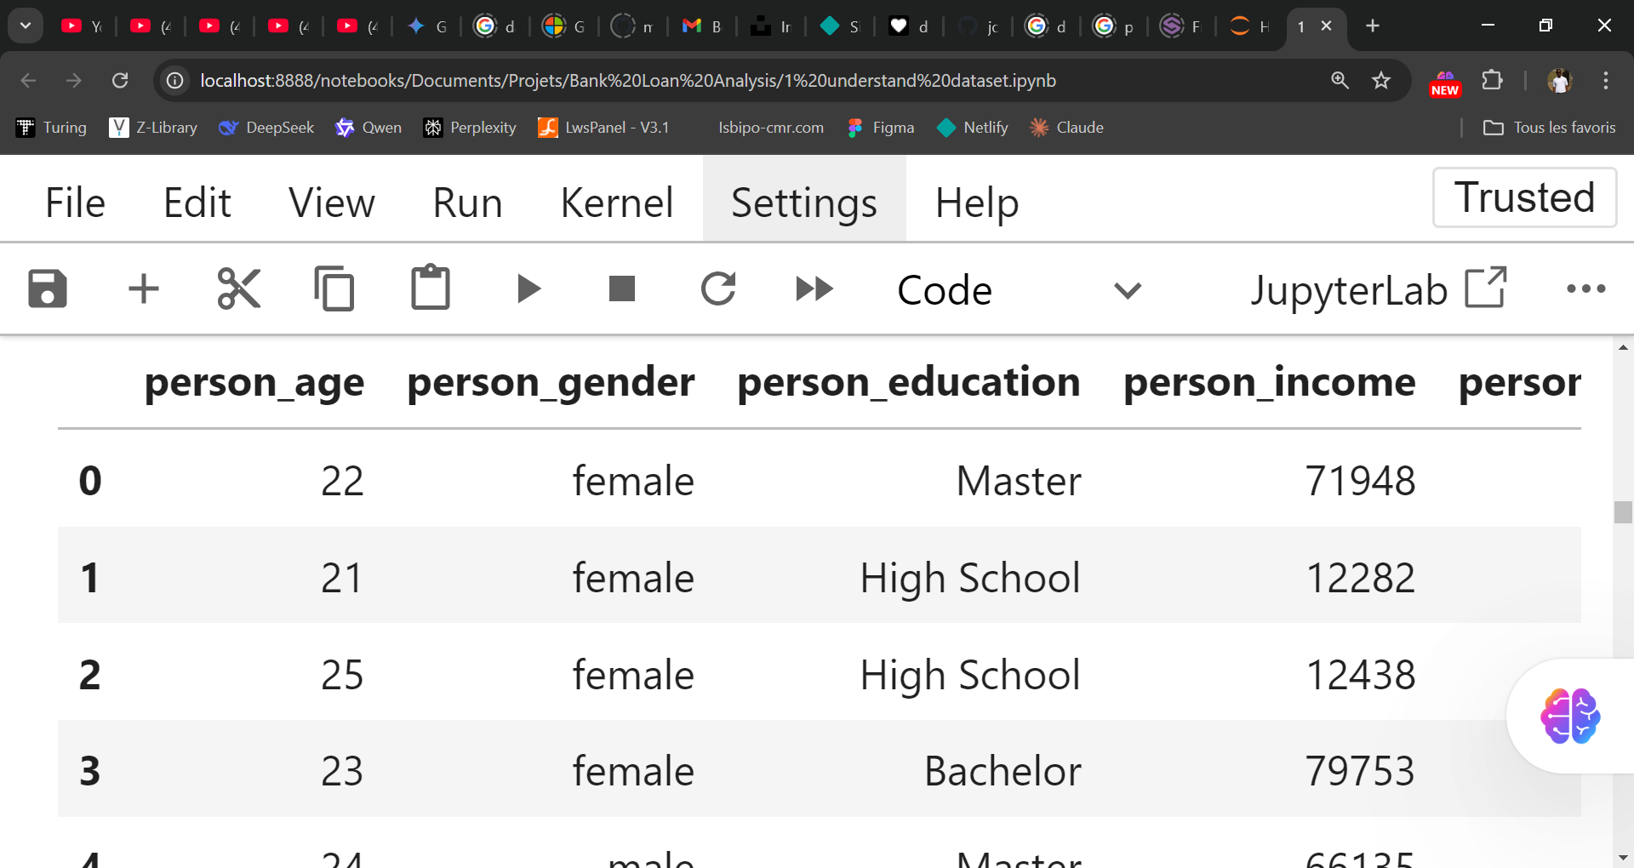
8
Understand the Problem
Understand and clean the dataset
Understand the dataset

Slide 9
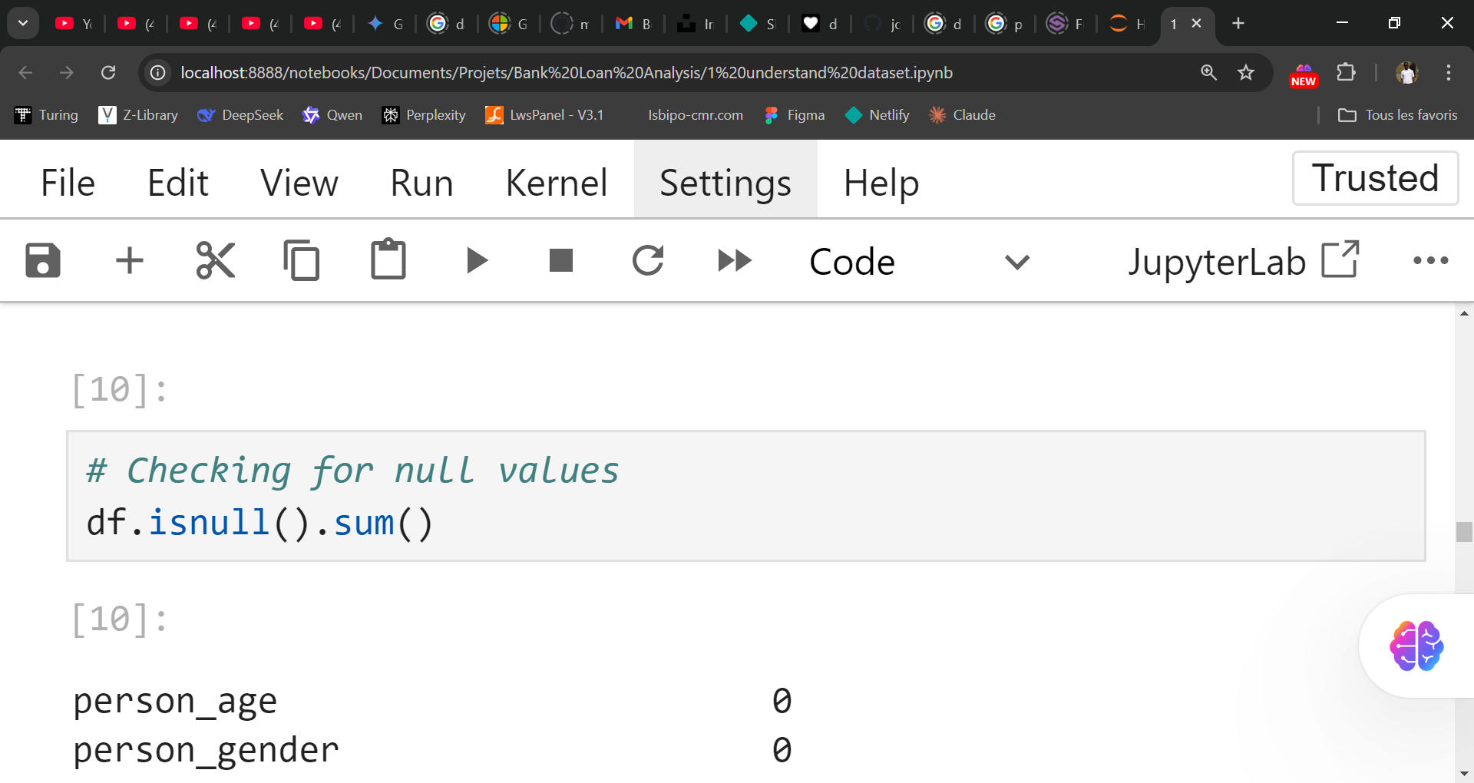
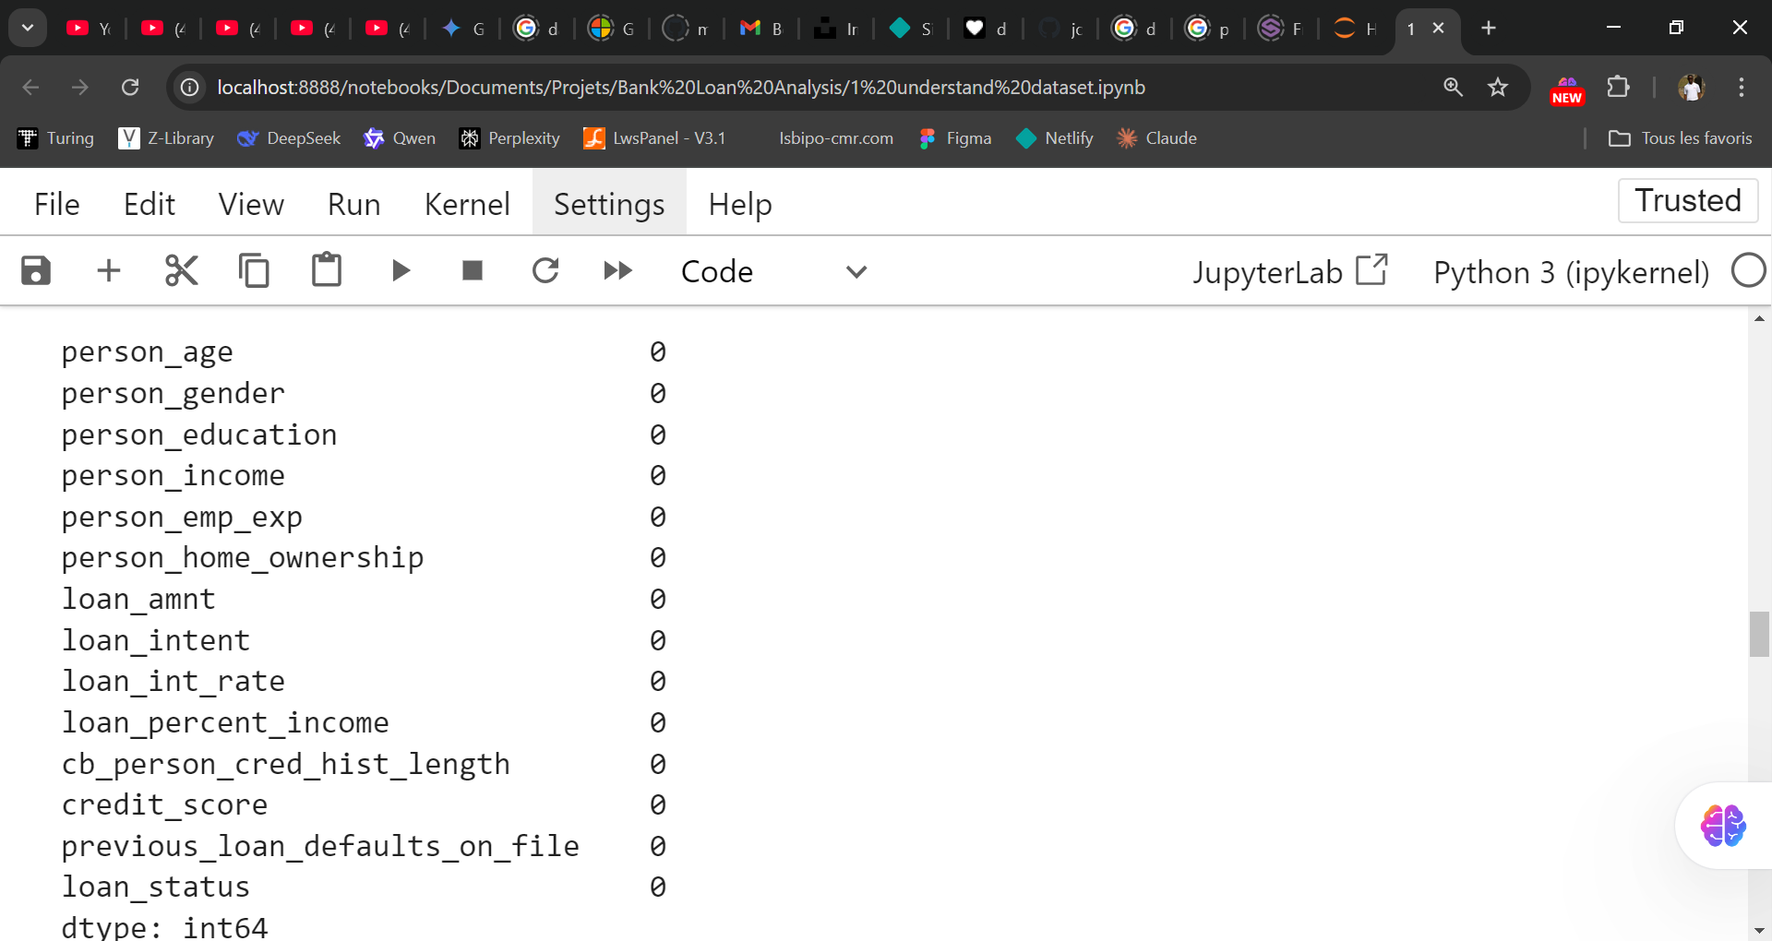
9
Understand the Problem
Understand and clean the dataset
Integrity Validation

Slide 10
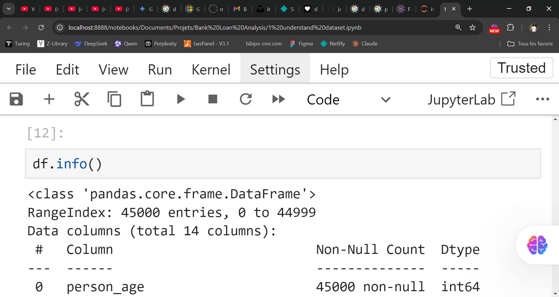
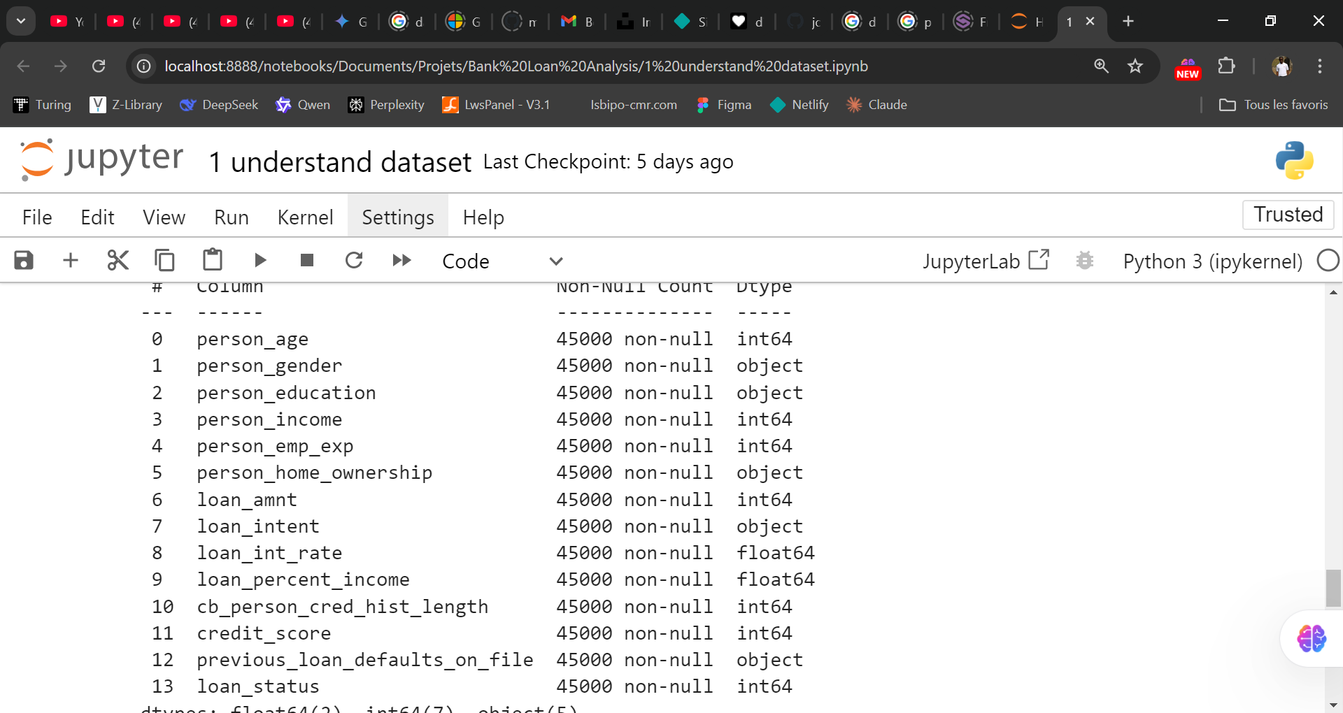
10
Understand the Problem
Understand and clean the dataset
Type Check

Slide 11
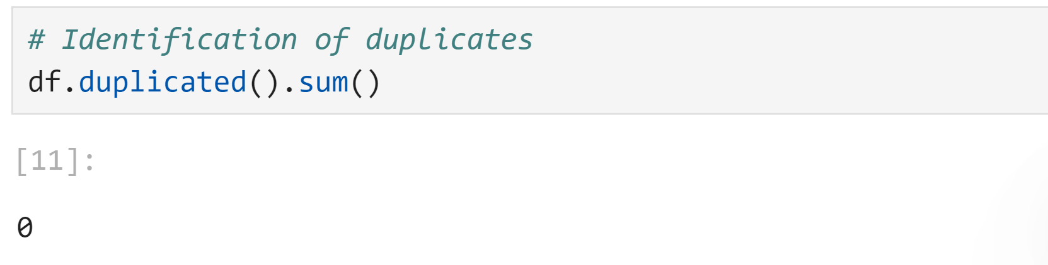
11
Understand the Problem
Understand and clean the dataset
Duplicated Identification

Slide 12
12
Understand the Problem
Conclusion Of this part
Integrity Validation
No incomplete records were identified during the null value check. This ensures that the analysis is performed on a complete dataset, without bias induced by missing data.
Type Check
The check confirmed that numeric and categorical data were correctly defined
Duplicate
No duplicates were present in the dataset. This ensures the reliability of aggregations and avoids bias during analysis.

Slide 13
13
Exploratory Data Analysis
It focuses on understanding key characteristics of the dataset, detecting patterns, and identifying correlations among variables to provide a foundation for further analysis.

Slide 14
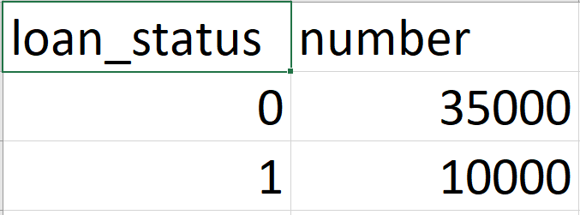
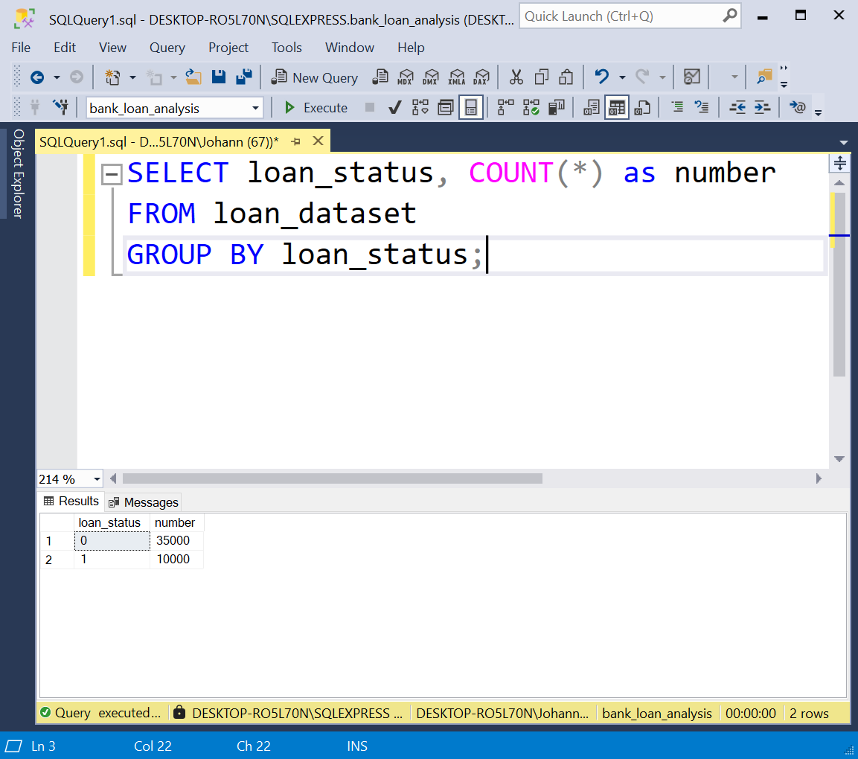
14
Exploratory Data Analysis
Loan Portfolio Analysis
Distribution of Loan Status: Understanding the ratio of approved vs. rejected loans.
Notes:
Just count values and filter by loan status

Slide 15
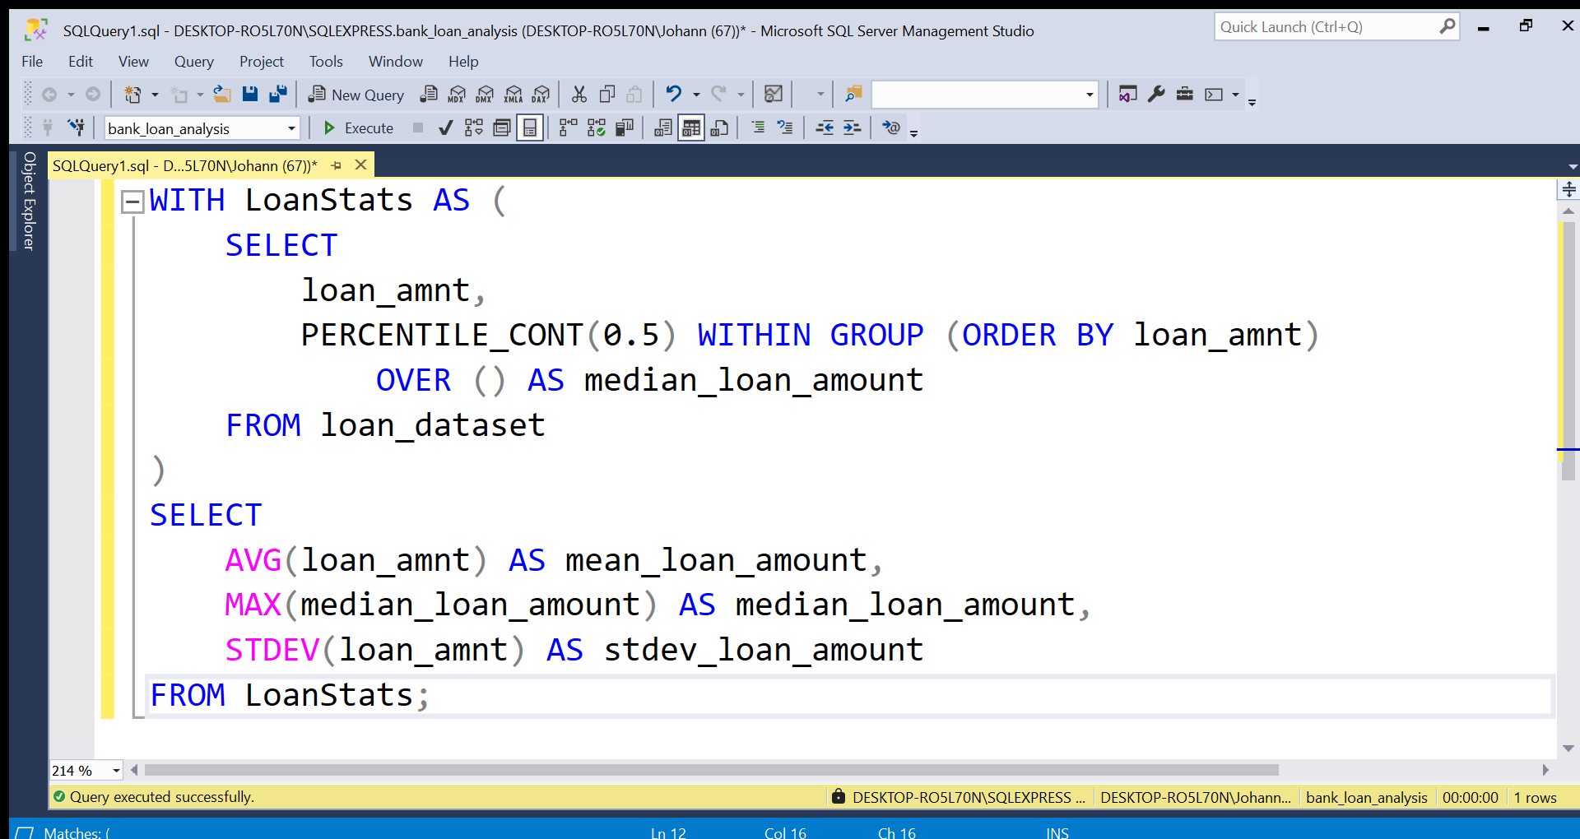
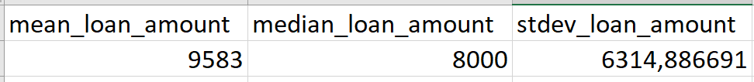
15
Exploratory Data Analysis
Loan Portfolio Analysis
Distribution of Loan Amounts: Analyzing the structure and statistical measures of loan amounts
Notes:
Calculate the mean, median and standard deviation of loan amount

Slide 16
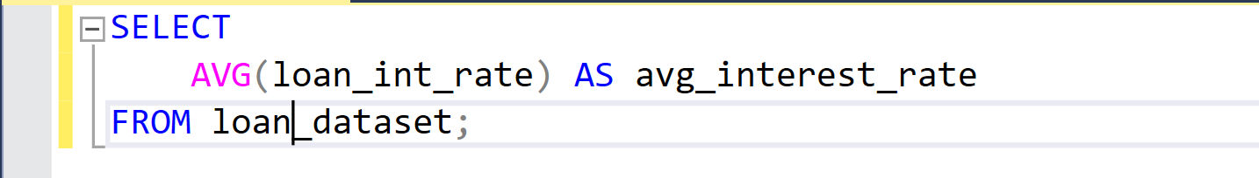
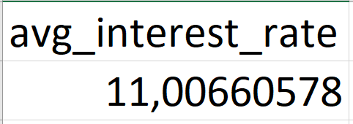
16
Exploratory Data Analysis
Loan Portfolio Analysis
Average Interest Rate Applied: Evaluating profitability and trends in interest rates.
Notes:
Mean of interest rate

Slide 17
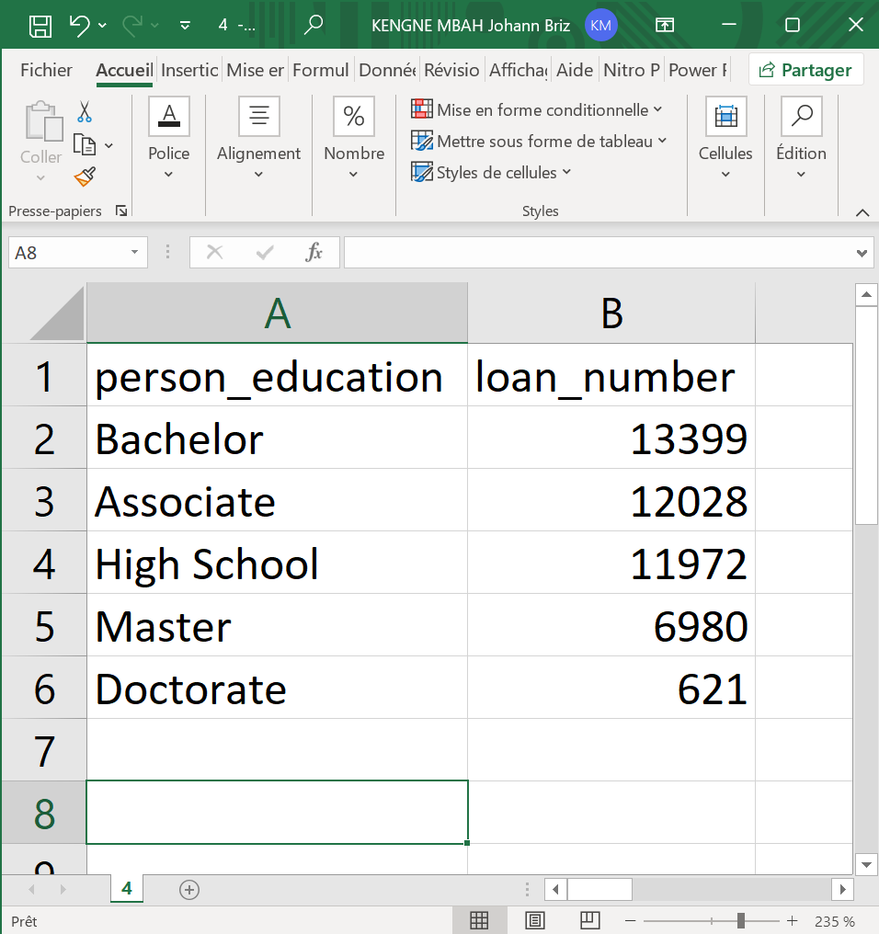
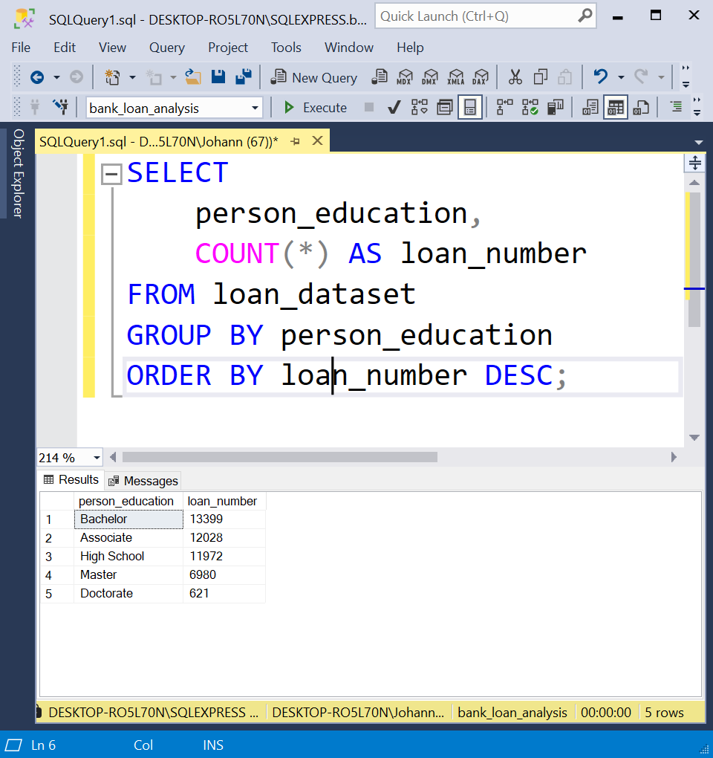
17
Exploratory Data Analysis
Borrower Profile
Loan Distribution by Borrower Education: Identifying common borrower profiles and risks
Notes:
Count values and filter by borrower education

Slide 18
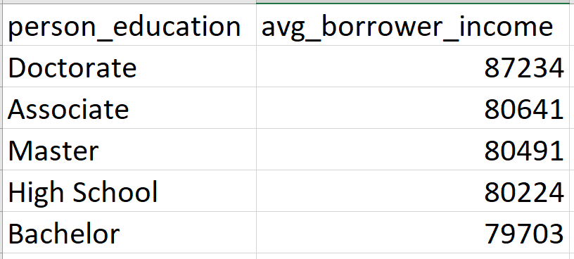
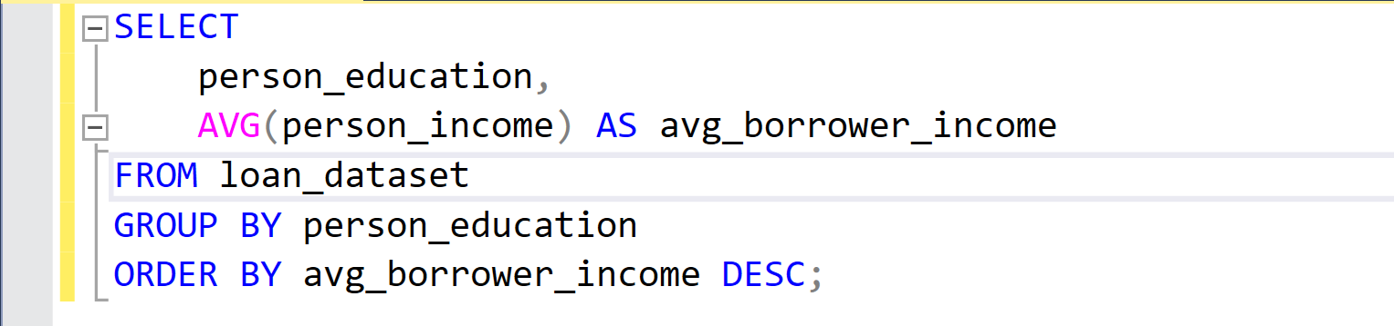
18
Exploratory Data Analysis
Borrower Profile
Average Income of Borrowers: Analyzing repayment capacity and loan behaviors
Notes:
Calculate the mean of borrower’s income and filter by borrower’s education

Slide 19
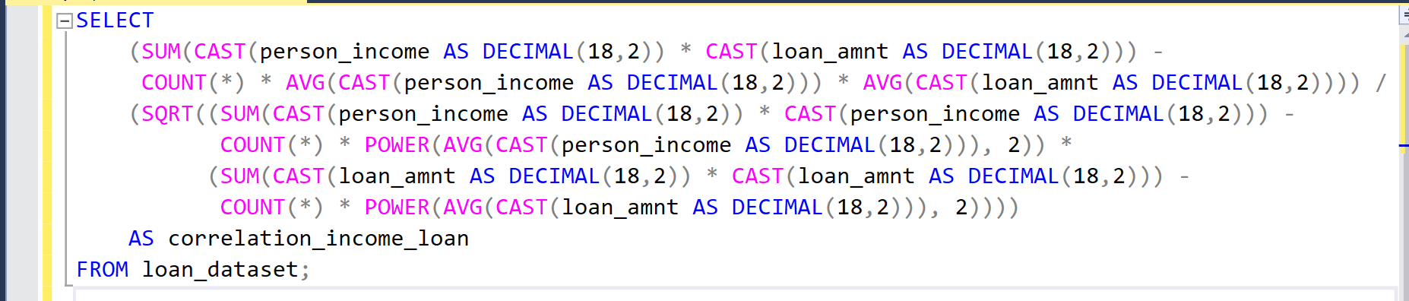
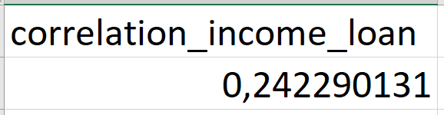
19
Exploratory Data Analysis
Borrower Profile
Correlation Between Income and Loan Amount: Exploring how income affects borrowing
Notes:
calculates the Pearson correlation coefficient (r) between person income and loan amount. We had to cast into DECIMAL because multiplying large numeric values can exceed the storage limit of BIGINT.

Slide 20
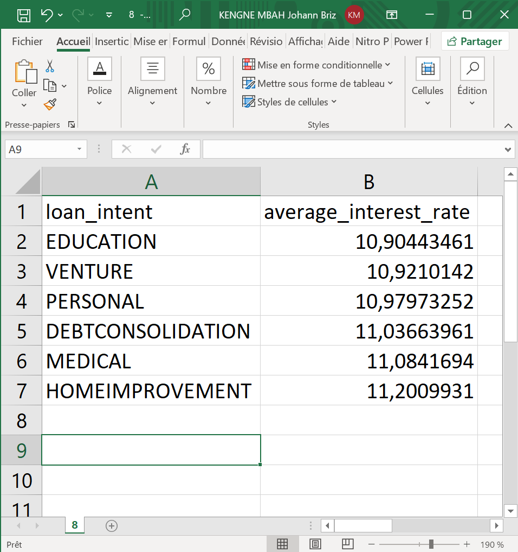
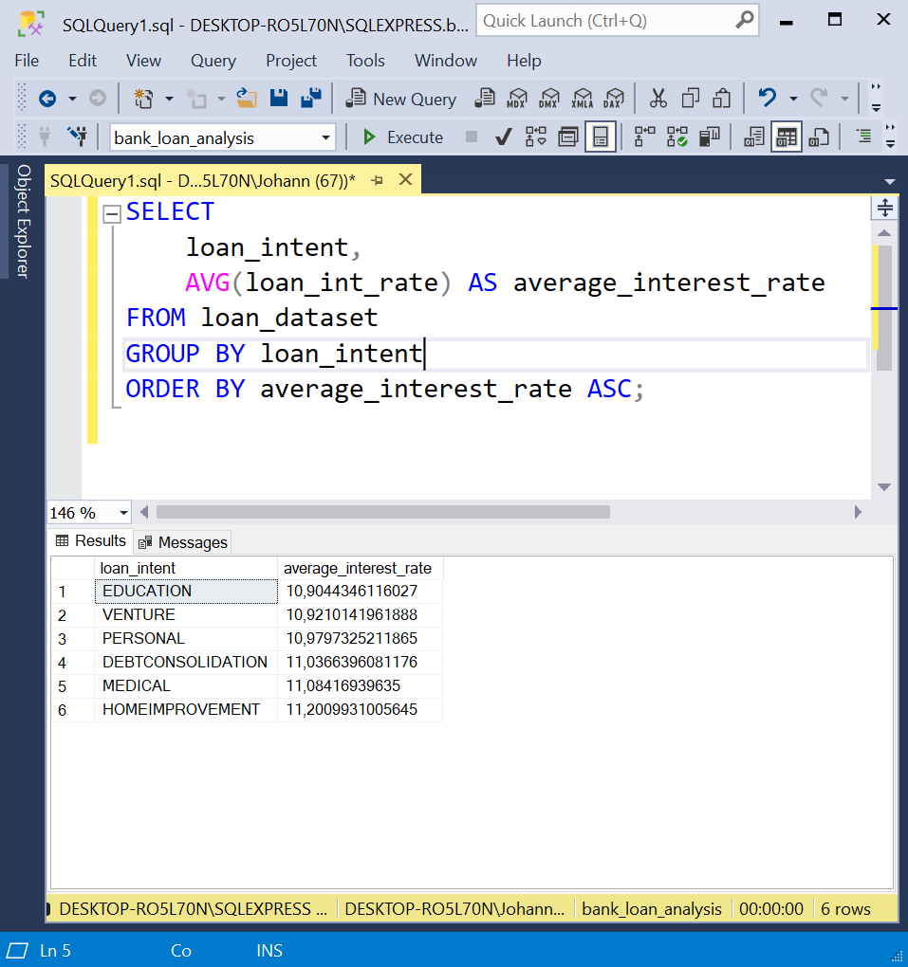
20
Exploratory Data Analysis
Loan Performance
Types of Loans with the Best Interest Rates: Evaluating pricing strategy and profitability
Notes:
Calculate the mean of interest rate and filter by borrower education

Slide 21
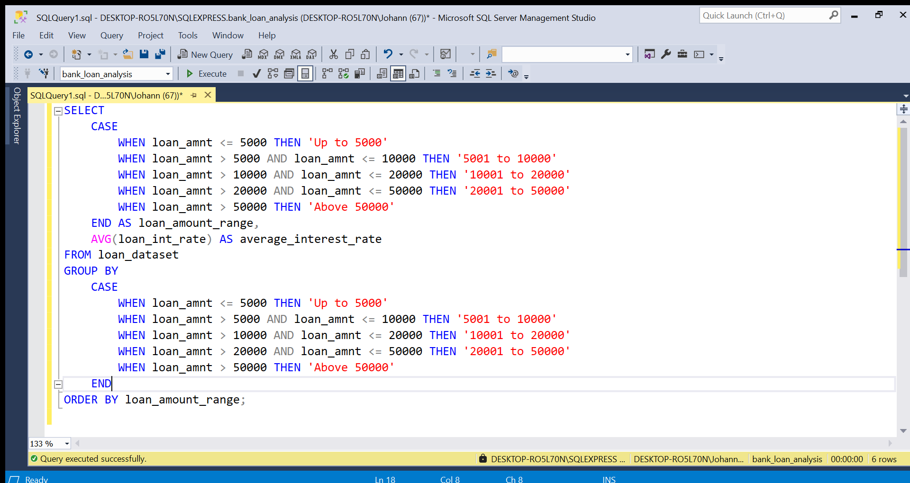
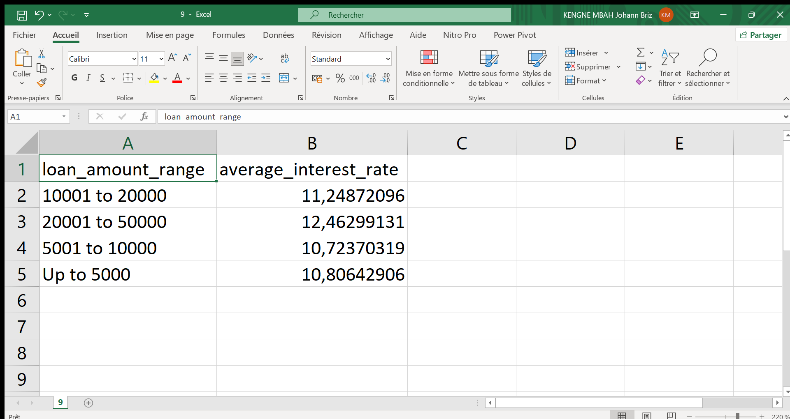
21
Exploratory Data Analysis
Loan Performance
Evolution of Interest Rates Based on Loan Amounts: Analyzing relationships between loan size and interest rates
Notes:
Calculate the mean of interest rate and filter by borrower loan amounts

Slide 22
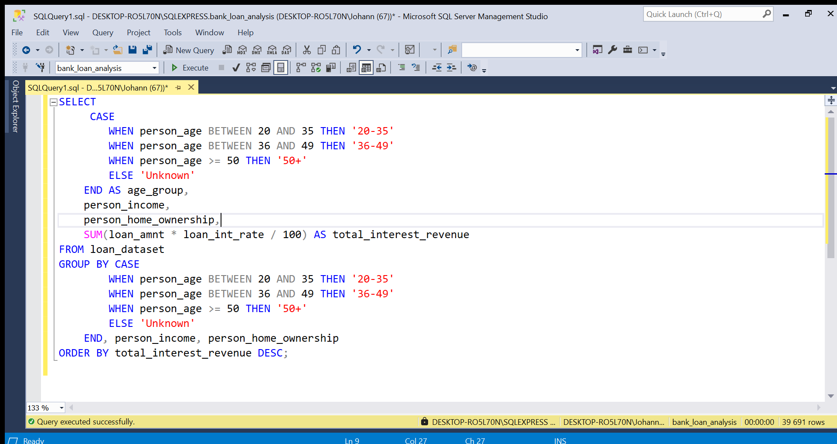
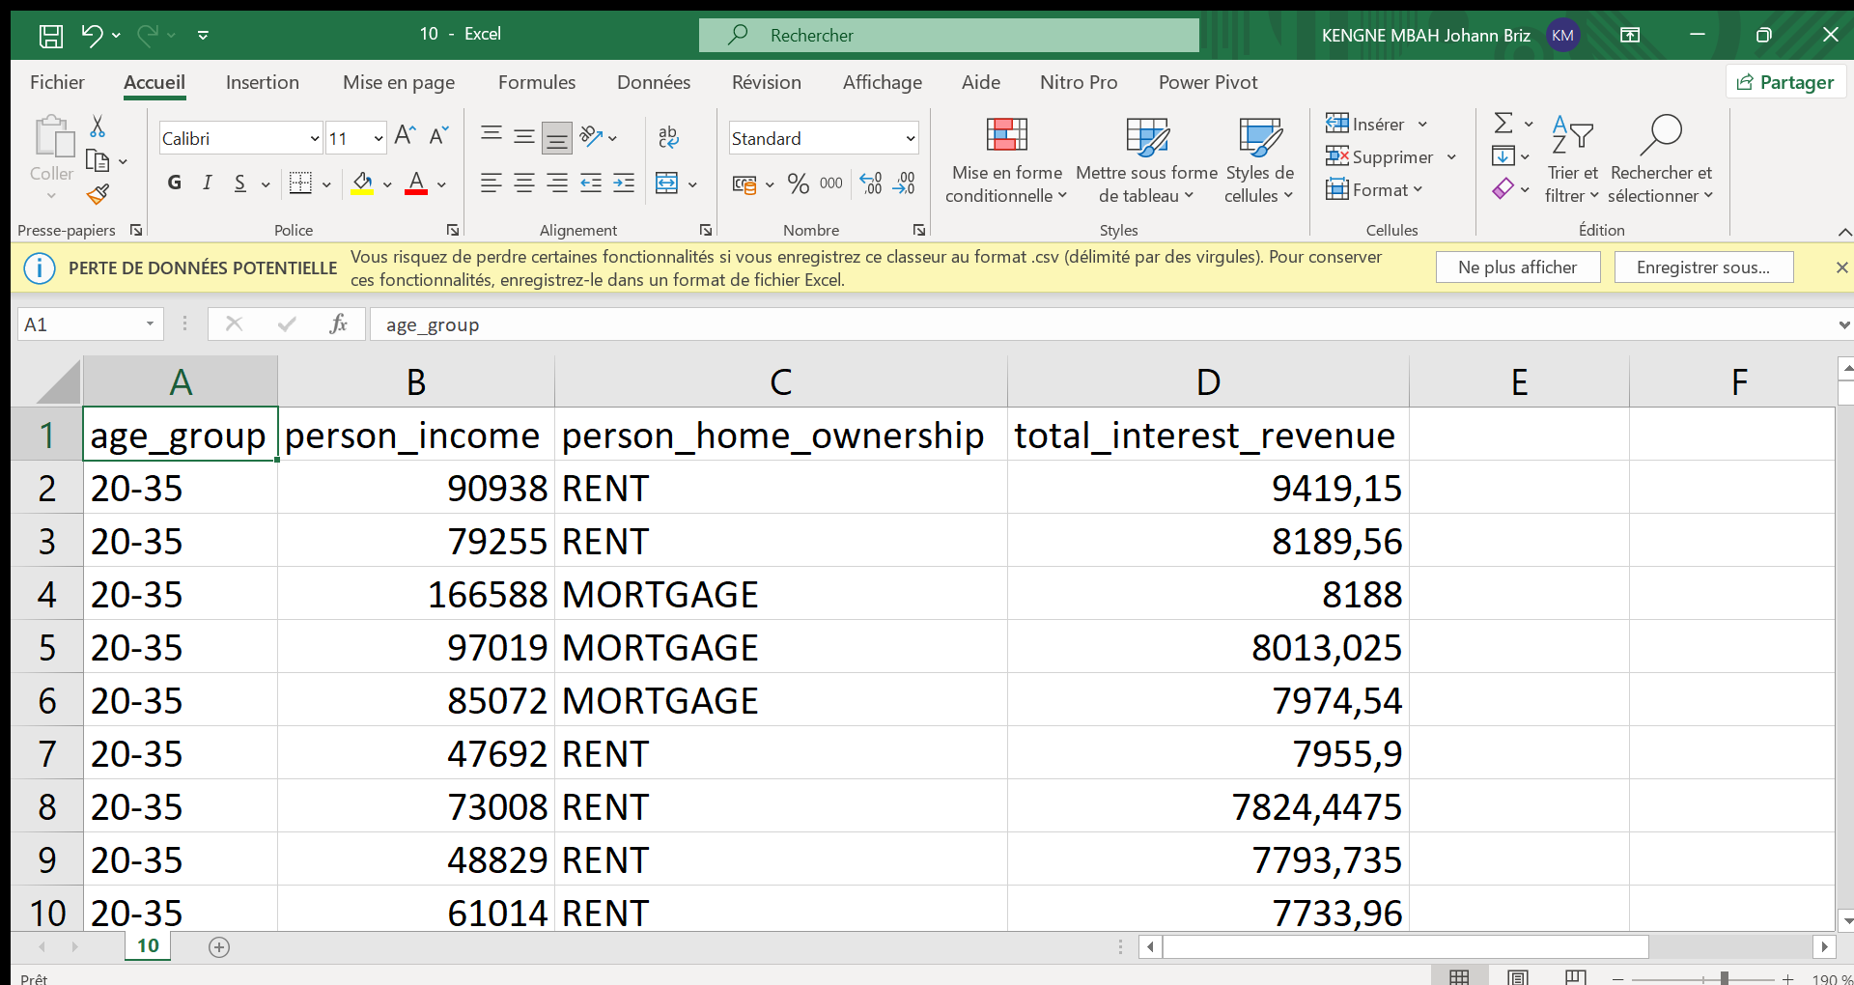
22
Exploratory Data Analysis
Loan Performance
Most Profitable Customer Segments: Identifying high-value borrowers to optimize marketing strategies
Notes:
We multiplied the loan amount by the interest rate to find the interest revenue. After that we sum them and filter by the home ownership and age.

Slide 23
23
Exploratory Data Analysis
Conclusion Of this part
The study highlights key trends in borrower behaviour and loan structuring at HSBC. The main challenge lies in optimizing credit criteria and revising pricing policies to maximize profitability while maintaining controlled risk.

Slide 24
24
Advanced Analysis
It explores the key factors influencing loan acceptance at HSBC, including borrower profiles, previous defaults, credit scores, and loan purposes. It aims to provide actionable insights for optimizing risk management and lending strategies

Slide 25
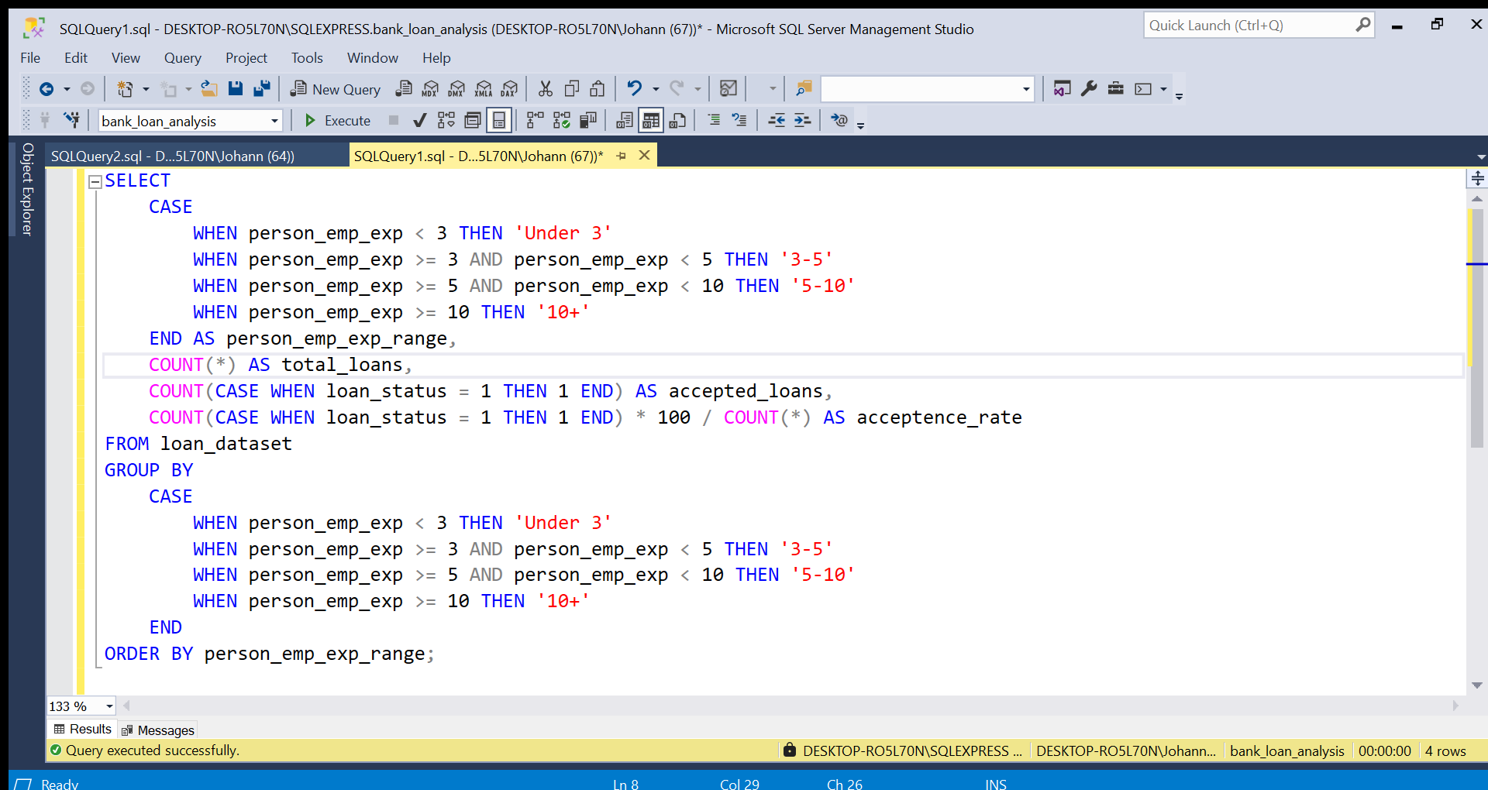
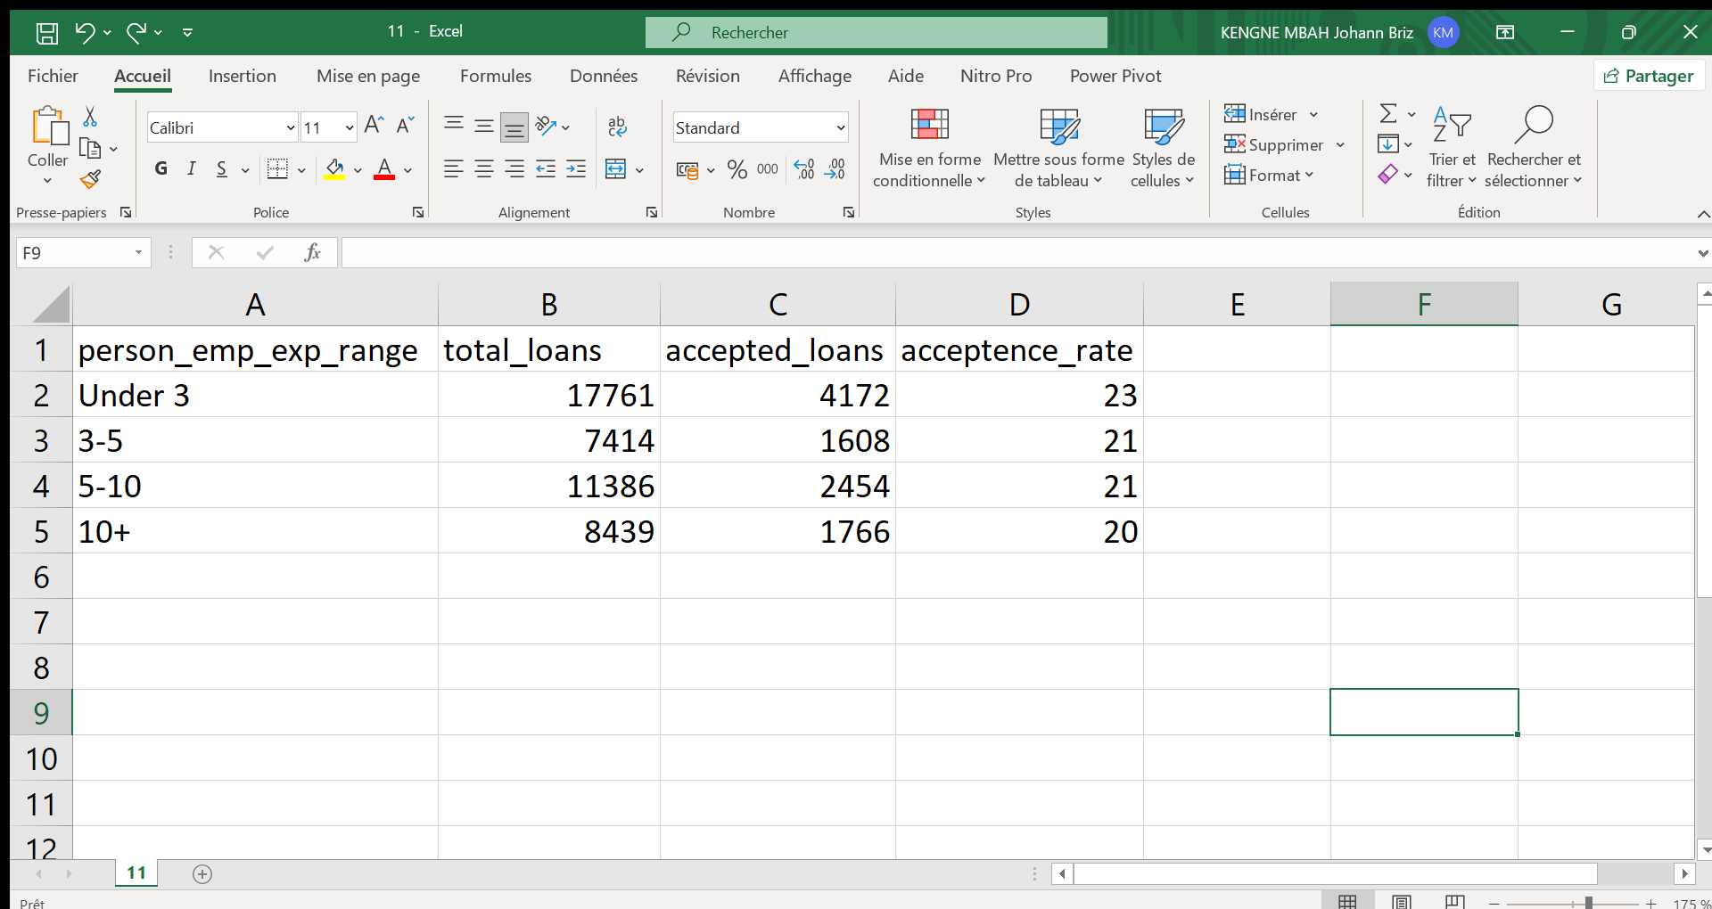
25
Advanced Analysis
Analysis of borrower solvency
Acceptance Rate Based on Work Experience
Notes:
Filter the approval rate by a range of ages

Slide 26
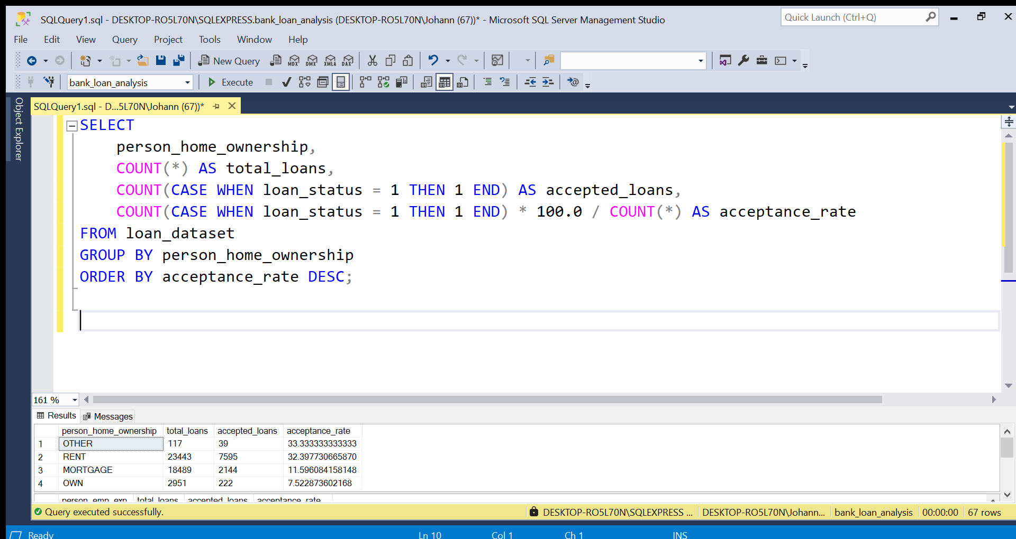
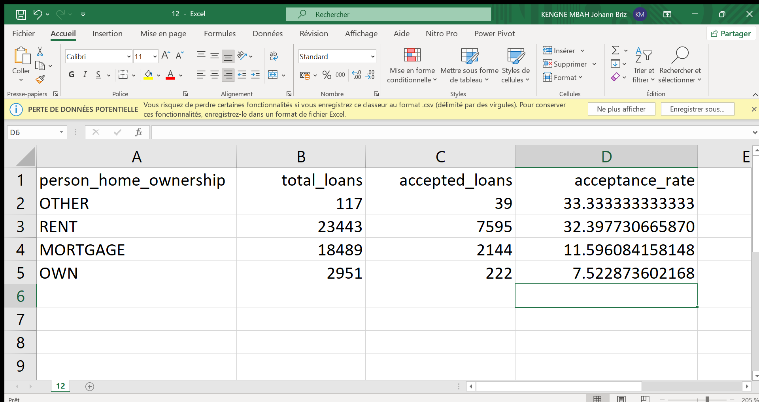
26
Advanced Analysis
Analysis of borrower solvency
Home Ownership and Loan Acceptance Rate
Notes:
Filter the approval rate by home ownership

Slide 27
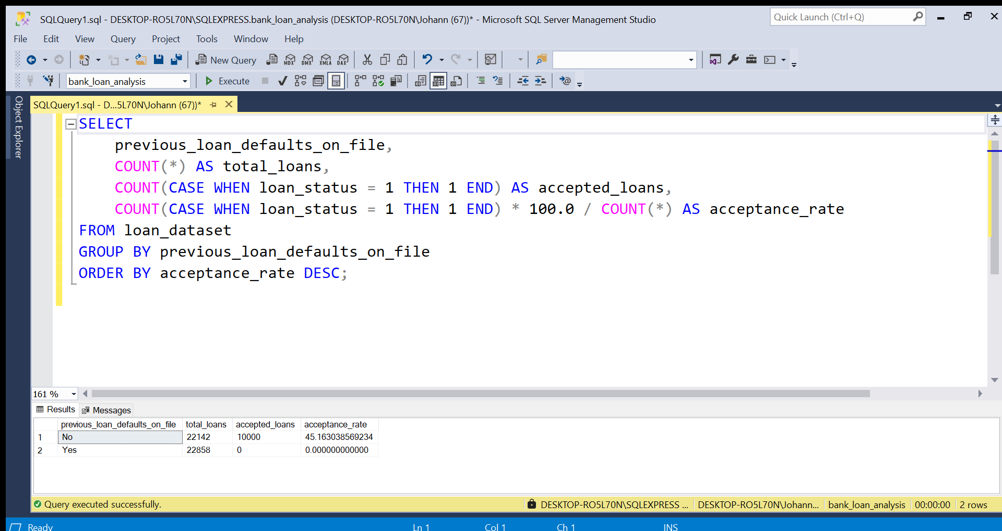
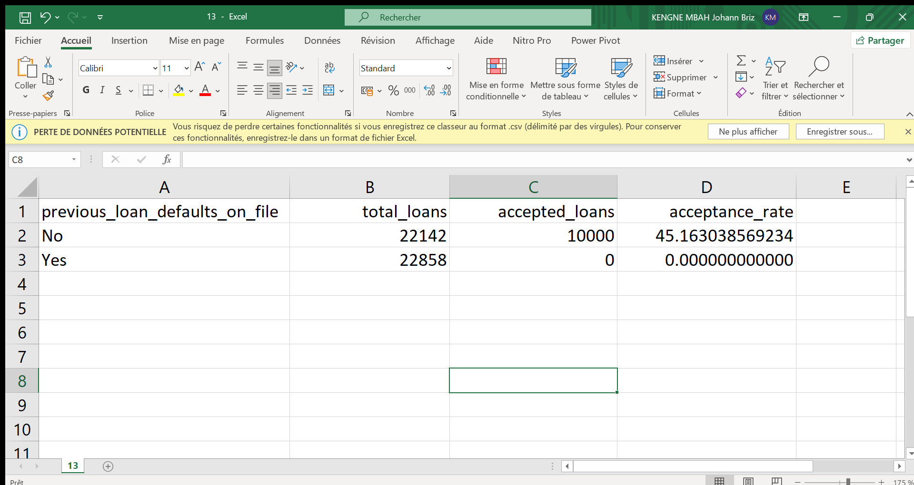
27
Advanced Analysis
Analysis of borrower solvency
Impact of Previous Loan Defaults
Notes:
Filter the approval rate by the previous loan default

Slide 28
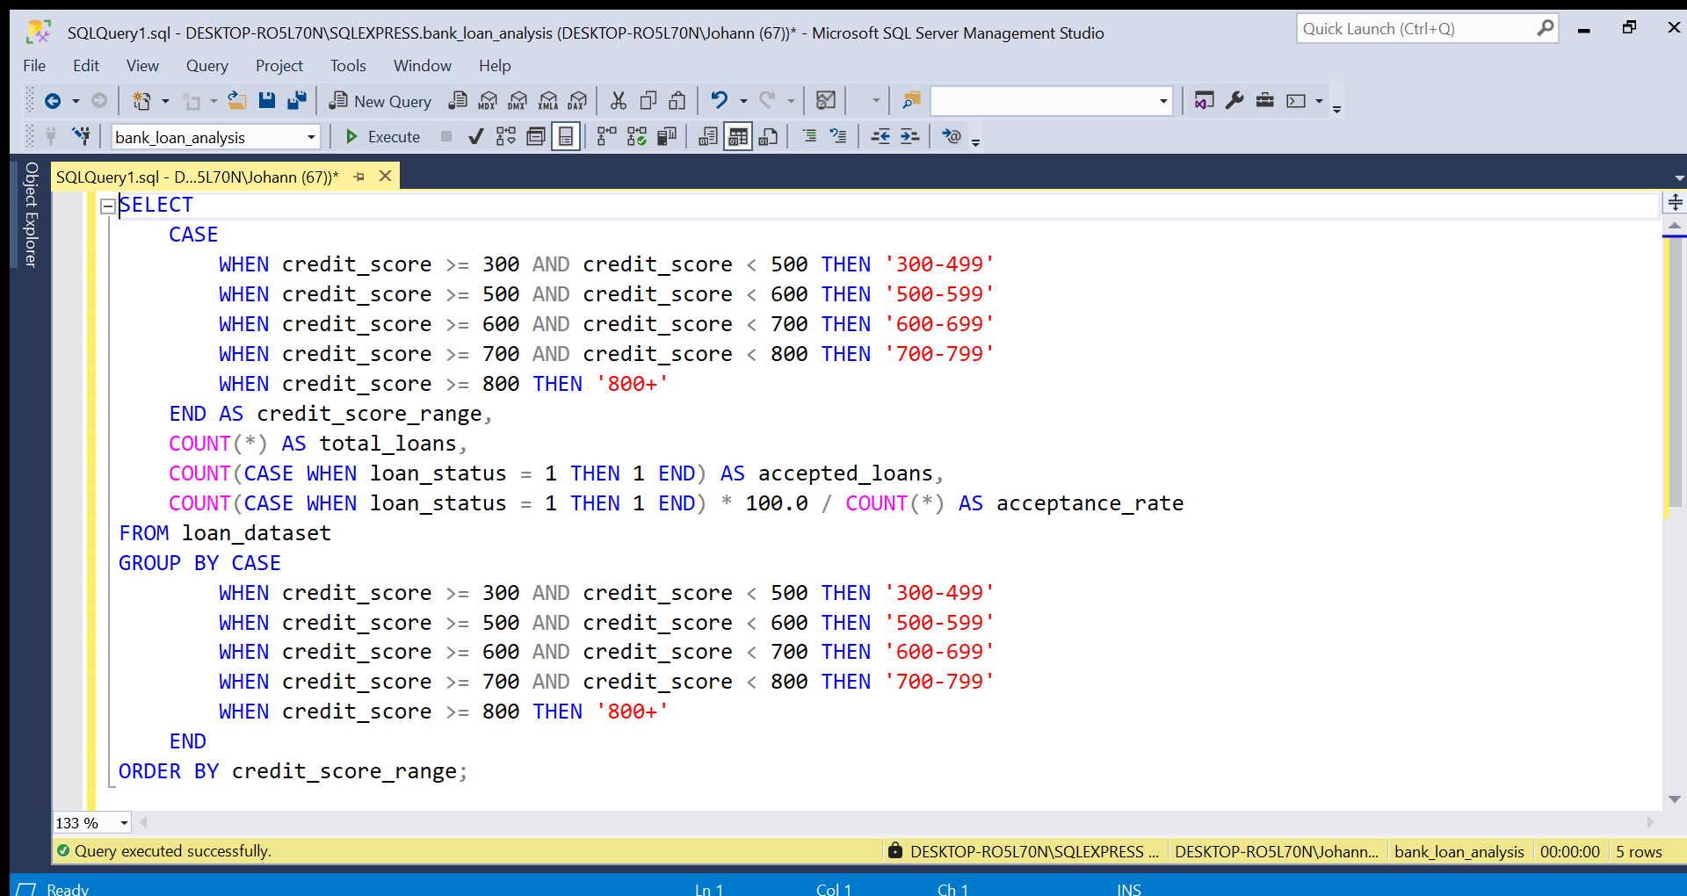
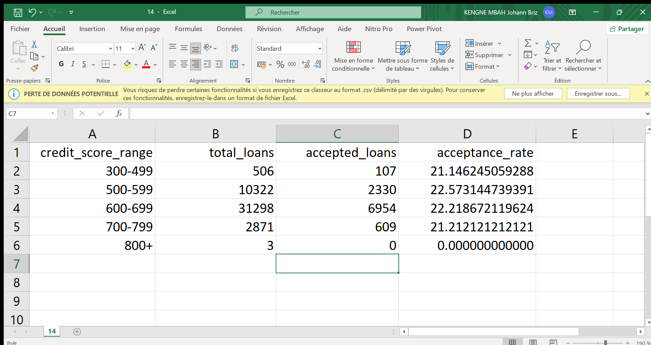
28
Advanced Analysis
Analysis of borrower solvency
Impact of Credit Score on Loan Acceptance
Notes:
Filter the approval rate by credit score

Slide 29
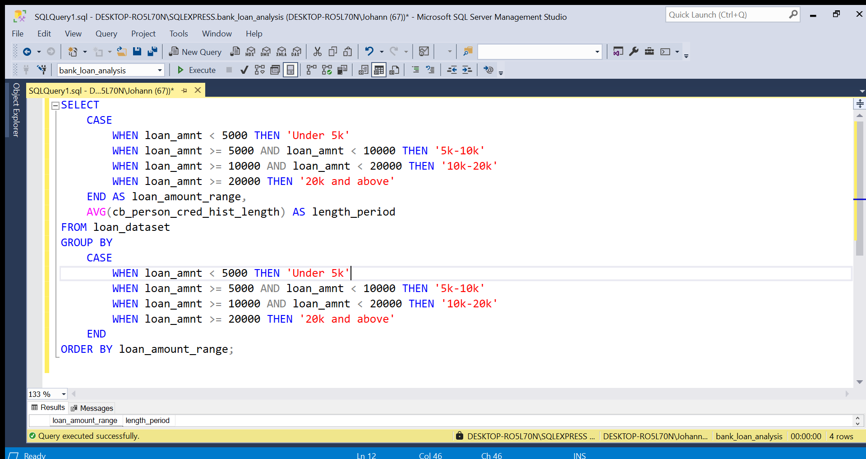
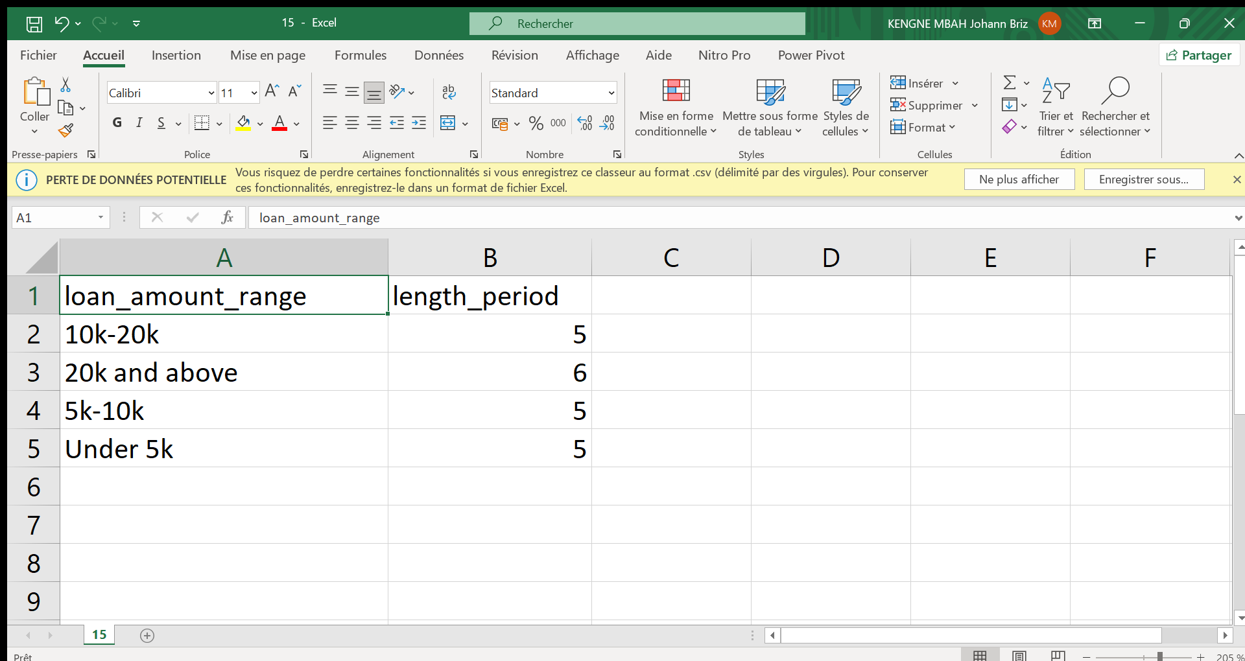
29
Advanced Analysis
Behavioural analysis and time trends
Speed of Repayment Based on Loan Amounts
Notes:
Calculate the mean of paiement period base on a range of loans amounts

Slide 30
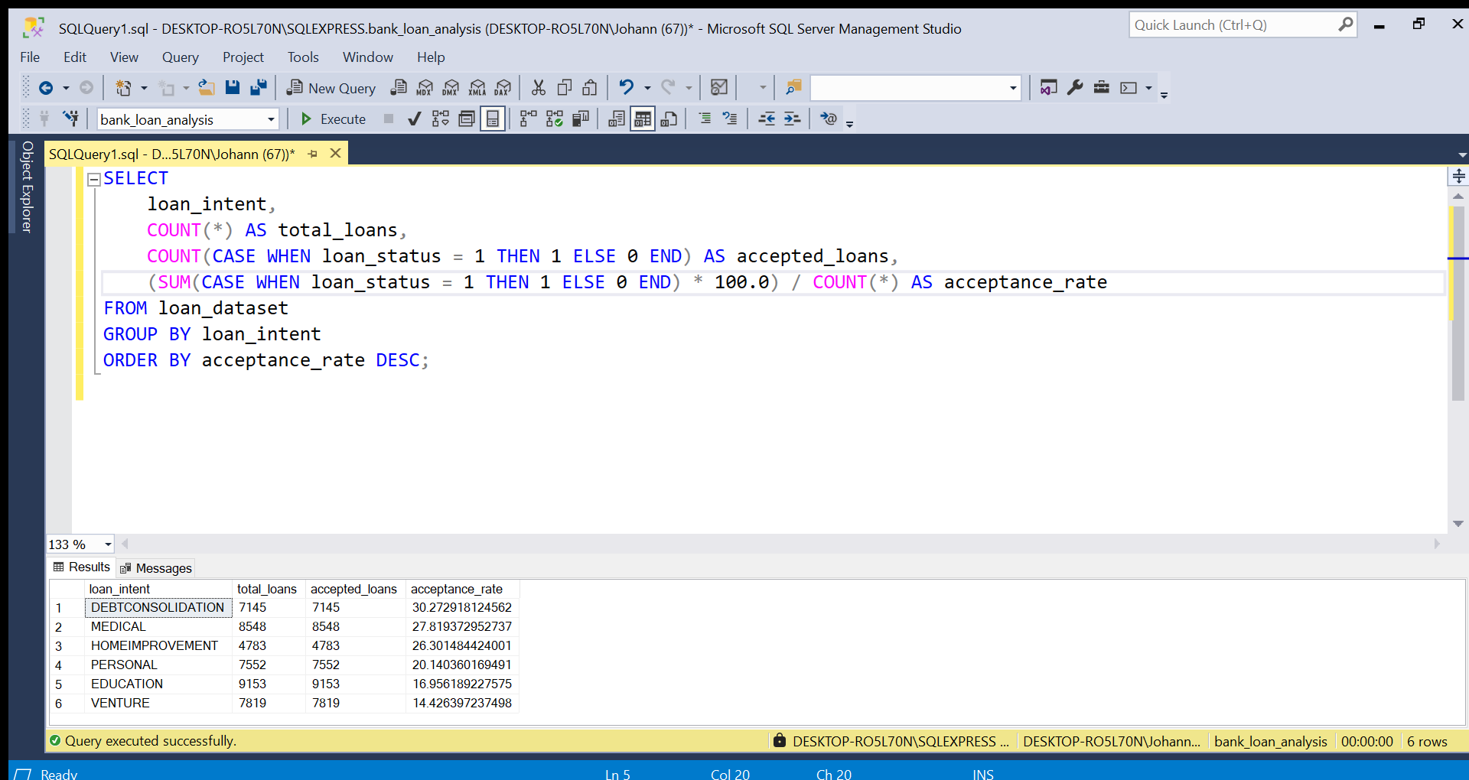
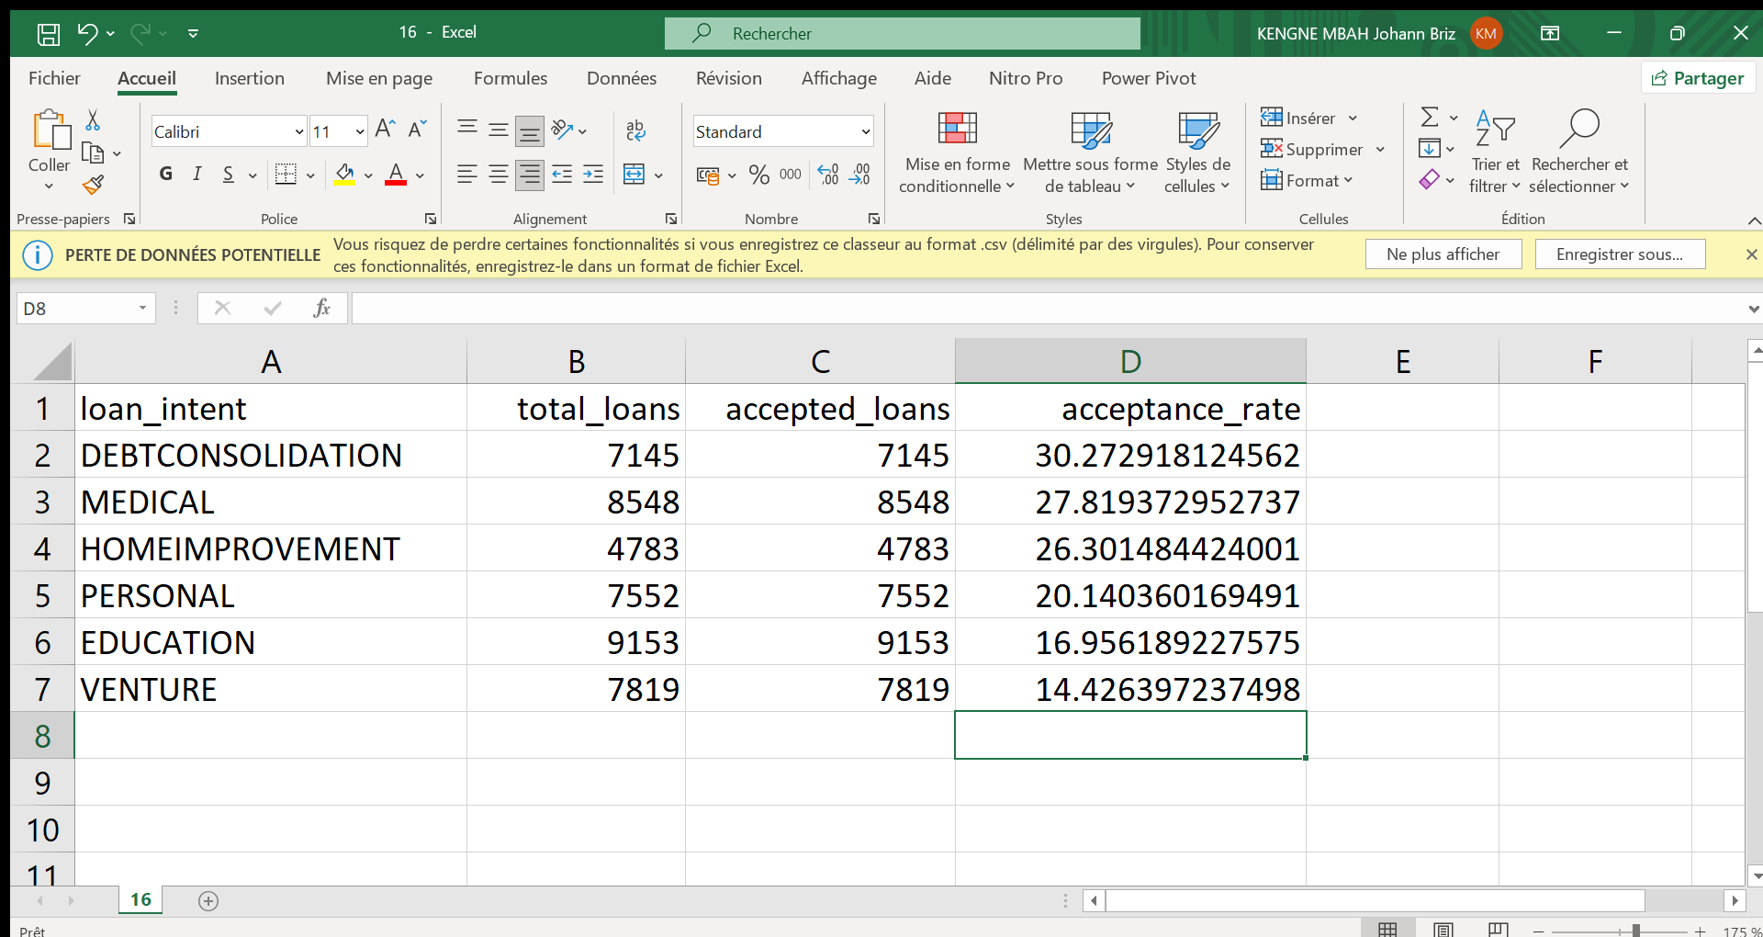
30
Advanced Analysis
Behavioural analysis and time trends
Distribution of Loans by Purpose
Notes:
Calculate the mean of approval rate base on the purpose

Slide 31
31
Advanced Analysis
Conclusion Of this part
adapting eligibility criteria based on the purpose of the loan and optimizing borrower scoring would give HSBC a better ability to target high-potential profiles, while strengthening the profitability and stability of its loan portfolio

Slide 32
32
Strategic Recommendations

Slide 33
33
Strategic Recommendations
Optimizing Loan Allocation Criteria
Professional Experience and Loan Acceptance
Prioritize borrowers with greater professional stability by adjusting eligibility criteria
Real Estate Ownership and Loan Acceptance
Reassess risk criteria for homeowners and tailor offers to the most reliable profiles
Implement a more nuanced scoring model for borrowers with a history of default
Default History and Loan Acceptance
Refine credit score analysis to identify critical acceptance thresholds
Credit Score and Acceptance Rate

Slide 34
34
Strategic Recommendations
Optimization of Loan Management and Borrower Behaviour
Relationship Between Borrowed Amount and Speed of Repayment
Adapt the repayment term and terms based on the borrowed amount and risk profile
Loan Acceptance According to Purpose
Prioritize loans for less risky uses while optimizing approval for other categories

Slide 35
35
Power BI Dashboard & Visualization
Create interactive dashboards featuring loan portfolio statistics. Include insights on approval rates by segment, interest revenue, and loan distribution.

Slide 36
36
Conclusion
The analysis provides HSBC UK with actionable insights to optimize lending strategies and enhance profitability while minimizing risk. Next steps include implementing recommendations and monitoring KPIs.

Slide 37
Thank you!
Do you have any questions?

